Slide 1
CPM and PERT - Network Models

Slide 2
WHAT IS CPM/PERT FOR?
CPM/PERT are fundamental tools of project management and are used for one of a kind, often large and expensive, decisions such as building docks, airports and starting a new factory. Such decisions can be described via mathematical models, but this is not essential. Some would argue that CPM/PERT is not a pure OR topic. CPM/PERT really falls into gray area that can be claimed by fields other than OR also.

Slide 3
8.1 Basic Definitions
A graph or network is defined by two sets of symbols:
Nodes: A set of points or vertices(call it V) are called nodes of a graph or network.
Arcs: An arc consists of an ordered pair of vertices and represents a possible direction of motion that may occur between vertices.
Nodes
1
2
Arc
1
2
Notes:
Vertices = simpul

Slide 4
Chain: A sequence of arcs such that every arc has exactly one vertex in common with the previous arc is called a chain.
Common vertex between two arcs
1
2
Notes:
Rantai: Sebuah urutan busur sehingga setiap arc memiliki tepat satu titik yang sama dengan busur sebelumnya disebut rantai. Vertex = puncak

Slide 5
Path: A path is a chain in which the terminal node of each arc is identical to the initial node of next arc.
For example in the figure below (1,2)-(2,3)-(4,3) is a chain but not a path; (1,2)-(2,3)-(3,4) is a chain and a path, which represents a way to travel from node 1 to node 4.
1
4
2
3

Slide 6
8.4 CPM and PERT
Network models can be used as an aid in the scheduling of large complex projects that consist of many activities.
CPM: If the duration of each activity is known with certainty, the Critical Path Method (CPM) can be used to determine the length of time required to complete a project.
PERT: If the duration of activities is not known with certainty, the Program Evaluation and Review Technique (PERT) can be used to estimate the probability that the project will be completed by a given deadline.

Slide 7
CPM and PERT are used in many applications including the following:
Scheduling construction projects such as office buildings, highways and swimming pools
Developing countdown and “hold” procedure for the launching of space crafts
Installing new computer systems
Designing and marketing new products
Completing corporate mergers
Building ships

Slide 8
Project Planning, Scheduling and Control
Planning: organized approach to accomplish the goal of minimizing elapsed time of project
  defines objectives and tasks; represents tasks interactions on a network; estimates time and resources
Scheduling: a time-phased commitment of resources
  identifies critical tasks which, if delayed, will delay the project’s completion time.
Control: means of monitoring and revising the progress of a project

Slide 9
Network Representation
Tasks (or activities) are represented by arcs
  Each task has a duration denoted by t_{j}
  Node 0 represents the “start” and node n denotes the “finish” of the project
Precedence relations are shown by “arcs”
  specify what other tasks must be completed before the task in question can begin.
A path is a sequence of linked tasks going from beginning to end
Critical path is the longest path

Slide 10
To apply CPM and PERT, we need a list of activities that make up the project. The project is considered to be completed when all activities have been completed. For each activity there is a set of activities (called the predecessors of the activity) that must be completed before the activity begins. A project network is used to represent the precedence relationships between activities. In the following discussions the activities will be represented by arcs and the nodes will be used to represent completion of a set of activities (Activity on arc (AOA) type of network).
A
B
1
2
3
Activity A must be completed before activity B starts

Slide 11
While constructing an AOA type of project diagram one should use the following rules:
Node 1 represents the start of the project. An arc should lead from node 1 to represent each activity that has no predecessors.
A node (called the finish node) representing the completion of the project should be included in the network.
Number the nodes in the network so that the node representing the completion time of an activity always has a larger number than the node representing the beginning of an activity.
An activity should not be represented by more than one arc in the network
Two nodes can be connected by at most one arc.
To avoid violating rules 4 and 5, it can be sometimes necessary to utilize a dummy activity that takes zero time.

Slide 12
Formulating the CPM Problem
Input Data:
Precedence relationships and durations
Decision Variable:
ES_{i} : Earliest starting times for each of the tasks
Objective:
Minimize the elapsed time of the project
where node n is the last node in the graph
Notes:
Precedence = pendahulu

Slide 13
Constraints
If t_{j} is the earliest starting time of a task, ES_{i} is the earliest starting time of an immediate predecessor and t_{i} is the duration of the immediate predecessor, then we have
ES_{j} ≥ ES_{i} + t_{i} for every arc (i, j)

Slide 14
Critical Path Definitions
Earliest Start Time (ES) is the earliest time a task can feasibly start
Earliest Finish Time (EF) is the earliest time a task can feasibly end
Latest Start Time (LS) is the latest time a task can feasibly start, without delaying the project at all.
Latest Finish Time (LF) is the latest time a task can feasibly end, without delaying the project at all

Slide 15
Critical Path Method
Forward Pass
  Go through the jobs in order
  Start each job at the earliest time while satisfying the precedence constraints
  It finds the earliest start and finish times
  EF_{i} = ES_{i} + t_{i}
  Earliest start time for an activity leaving a particular node is equal to the largest of the earliest finish times for all activities entering the node.

Slide 16
CPM: The Backward Pass
Fix the finishing time
Look at tasks in reverse order
Lay out tasks one at a time on the Gantt chart starting at the finish and working backwards to the start
Start the task at its latest starting time
  LS_{i} = LF_{i} - t_{i}
  Latest finish time for an activity entering a particular node is equal to the smallest of the latest start times for all activities leaving the node.

Slide 17
CPM and Critical Path
Theorem: The minimum length of the schedule is the length of the longest path.
The longest path is called the critical path
Look for tasks whose earliest start time and latest start time are the same. These tasks are critical, and are on a critical path.

Slide 18
CPM and Critical Path
Critical path are found by identifying those tasks where ES=LS (equivalently, EF=LF)
No flexibility in scheduling tasks on the critical path
The makespan of the critical path equals the LF of the final task
Slack is the difference between LS and ES, or LF and EF. An activity with a slack of zero is on the critical path

Slide 19
An example for CPM
Widgetco is about to introduce a new product. A list of activities and the precedence relationships are given in the table below. Draw a project diagram for this project.
Activity | Predecessors | Duration(days)
A:train workers | - | 6
B:purchase raw materials | - | 9
C:produce product 1 | A, B | 8
D:produce product 2 | A, B | 7
E:test product 2 | D | 10
F:assemble products 1&2 | C, E | 12

Slide 20
Project Diagram for Widgetco
C 8
F 12
3
5
6
A 6
D 7
1
Dummy
E 10
B 9
2
4
Node 1 = starting node
Node 6 = finish node

Slide 21
Project Diagram for Widgetco Forward Pass (ES,EF)
(9,17)
(26,38)
C 8
F 12
(0,6)
3
5
6
A 6
D 7
1
Dummy
E 10
(16,26)
B 9
(9,16)
2
4
(0,9)
Node 1 = starting node
Node 6 = finish node

Slide 22
Project Diagram for Widgetco Backward Pass (LS,LF)
(18,26)
(26,38)
C 8
F 12
(3,9)
3
5
6
A 6
D 7
1
Dummy
E 10
(16,26)
B 9
(9,16)
2
4
(0,9)
Node 1 = starting node
Node 6 = finish node

Slide 23
For Widgetco example ES(i)’s and LS(i)’s are as follows:
Activity | ES(i) | LS(i)
A | 0 | 3
B | 0 | 0
C | 9 | 18
D | 9 | 9
E | 16 | 16
F | 26 | 26

Slide 24
According to the table on the previous slide the slacks are computed as follows:
Activity B: 0
Activity A: 3
Activity D: 0
Activity C: 9
Activity E: 0
Activity F: 0

Slide 25
Critical path
An activity with a slack of zero is a critical activity
A path from node 1 to the finish node that consists entirely of critical activities is called a critical path.
For Widgetco example B-D-E-F is a critical path.
The Makespan is equal to 38

Slide 26
On Incorporating Variability
Program Evaluation and Review Technique (PERT)
  Attempts to incorporate variability in the durations
  Assume mean, μ, and variance, σ², of the durations can be estimated
Simulation
  Model variability using any distribution
  simulate to see how long a schedule will take

Slide 27
PERT
CPM assumes that the duration of each activity is known with certainty. For many projects, this is clearly not applicable. PERT is an attempt to correct this shortcoming of CPM by modeling the duration of each activity as a random variable. For each activity, PERT requires that the project manager estimate the following three quantities:
a : estimate of the activity’s duration under the most favorable conditions
b : estimate of the activity’s duration under the least favorable conditions
m : most likely value for the activity’s duration

Slide 28
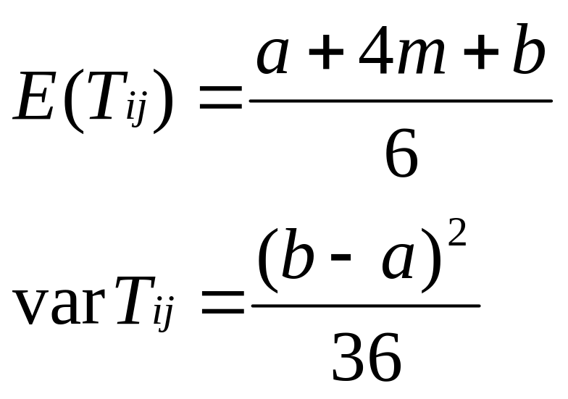
Let T_{ij} be the duration of activity (i,j). PERT requires the assumption that T_{ij} follows a beta distribution. According to this assumption, it can be shown that the mean and variance of T_{ij} may be approximated by

Slide 29
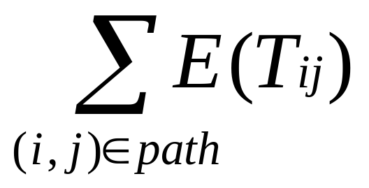
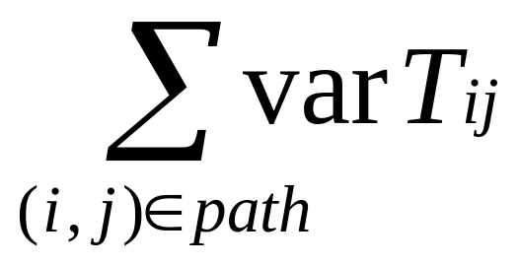
PERT requires the assumption that the durations of all activities are independent. Thus,
: expected duration of activities on any path
: variance of duration of activities on any path

Slide 30
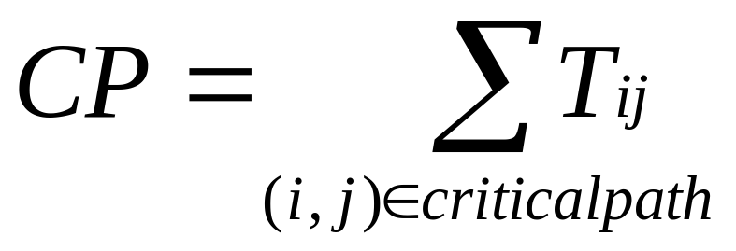
Let CP be the random variable denoting the total duration of the activities on a critical path found by CPM. PERT assumes that the critical path found by CPM contains enough activities to allow us to invoke the Central Limit Theorem and conclude that the following is normally distributed:

Slide 31
a, b and m for activities in Widgetco
Activity | a | b | m
(1,2) | 5 | 13 | 9
(1,3) | 2 | 10 | 6
(3,5) | 3 | 13 | 8
(3,4) | 1 | 13 | 7
(4,5) | 8 | 12 | 10
(5,6) | 9 | 15 | 12

Slide 32
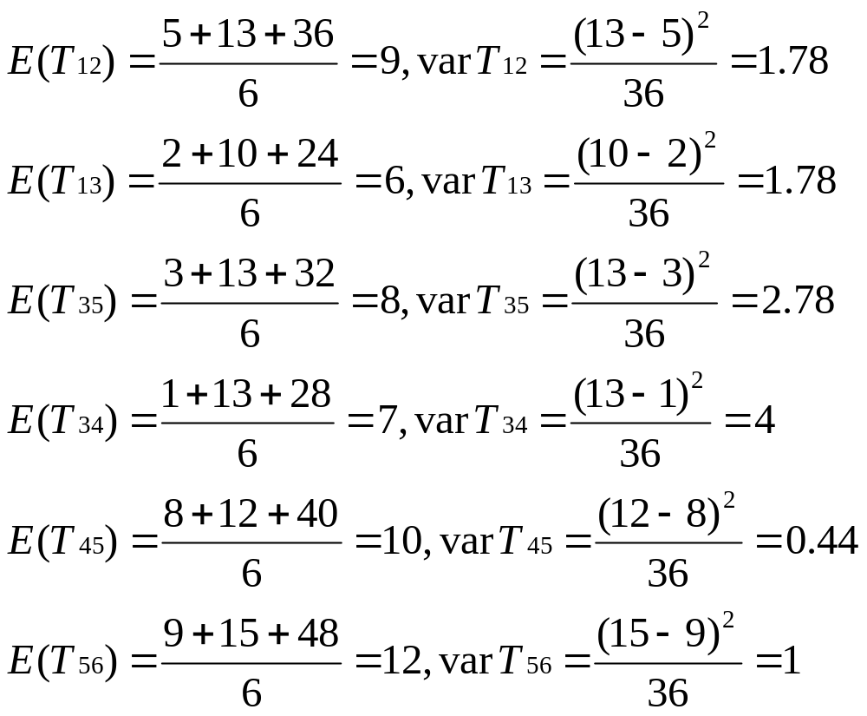
According to the table on the previous slide:

Slide 33
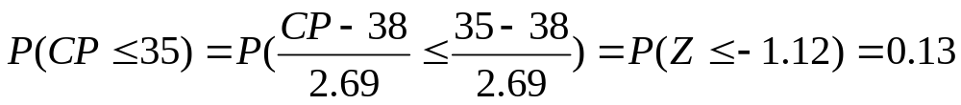
Of course, the fact that arc (2,3) is a dummy arc yields
E(T₂₃)=varT₂₃=0
The critical path was B-D-E-F. Thus,
E(CP)=9+0+7+10+12=38
varCP=1.78+0+4+0.44+1=7.22
Then the standard deviation for CP is (7.22)^{1/2}=2.69
And

Slide 34
PERT implies that there is a 13% chance that the project will be completed within 35 days.

